Slide 1
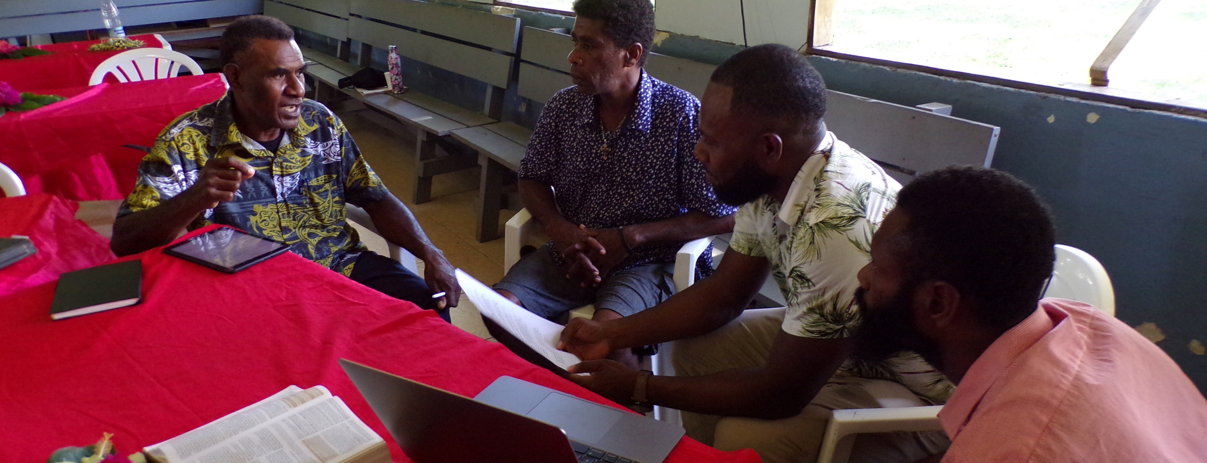
For which of you who desires to build a tower does not first sit down and count the cost to calculate if he has what he needs to complete it? Otherwise, when he has laid a foundation and is not able to finish, all who see it will begin to mock him, saying, “This man began to build and was not able to finish” (Luke 14:28-30).
All Scripture taken from the English Unlocked Literal Bible (ULB), ©2017, 2022 Wycliffe Associates, Available at https://bibleineverylanguage.org/translations, licensed under the Creative Commons Attribution-ShareAlike 4.0 International License.
The English ULB is based on the unfoldingWord® Literal Text, CC BY-SA 4.0. The original work of the unfoldingWord® Literal Text is available at https://unfoldingword.bible/ult/.
Completion Timeline Strategies

Slide 2
?
Consider

Slide 3
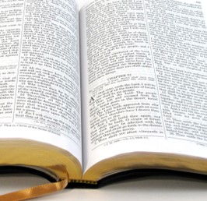
Setting Goals
New Testament: 7,957 verses
21 translators, 25 verses a week, 4 months

Slide 4
Timetable for Drafting: New Testament
Number of Translators | Verses Drafted per Week | Time to Complete Drafting
6 | 25 | 1 Year
15 | 25 | 5 ½ Months
21 | 25 | 4 Months
35 | 25 | 2 ½ Months

Slide 5
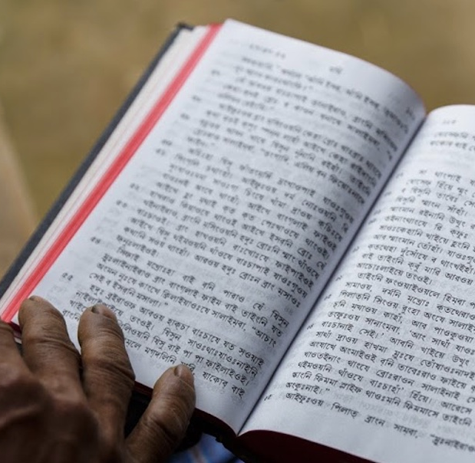
Setting Goals
New Testament: 7,957 verses
21 translators, 25 verses a week, 4 months
Old Testament: 23,145 verses
21 translators, 25 verses a week, 1 year

Slide 6
Timetable for Drafting: Old Testament
Number of Translators | Verses Drafted per Week | Time to Complete Drafting
6 | 25 | 3 Years
15 | 25 | 1 Year and 3 Months
21 | 25 | 11 Months
35 | 25 | 7 Months

Slide 7
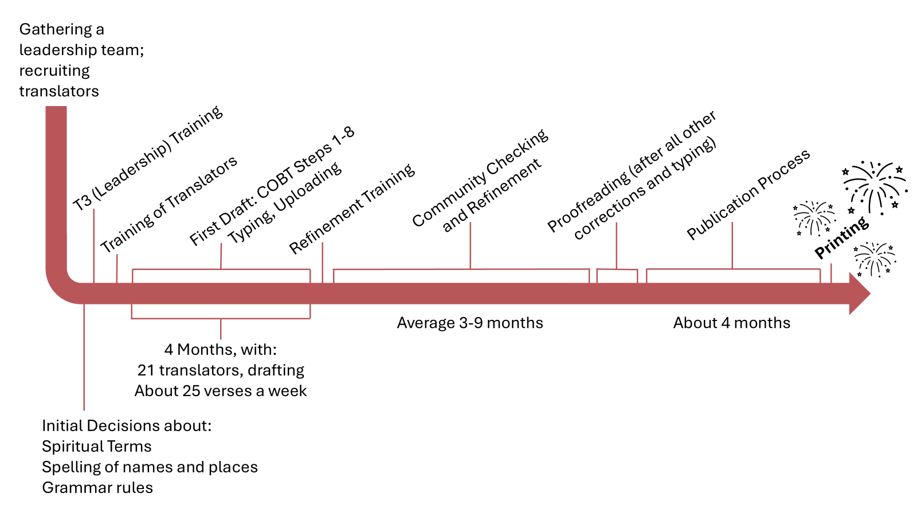
Sample Timeline for New Testament Completion

Slide 8
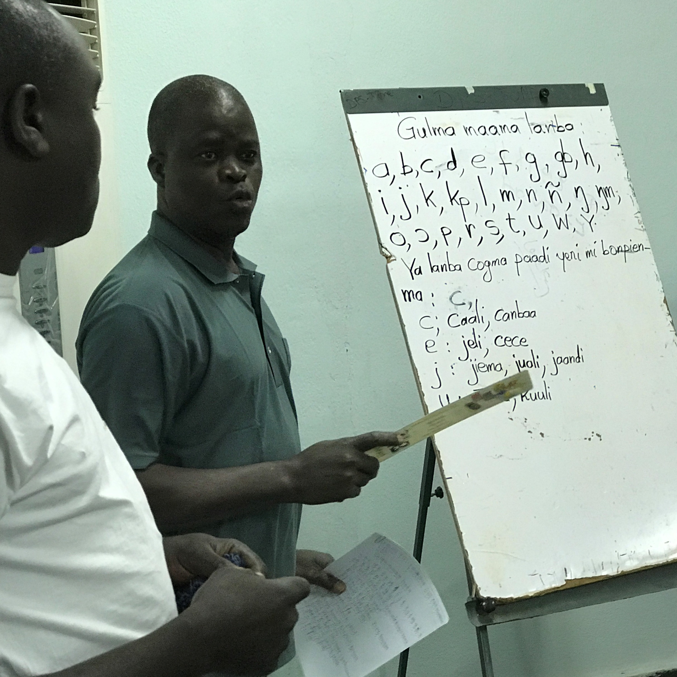
Leadership Roles
Teach/train
Inspire/motivate
Organize
Set goals
Gauge progress
Hold translators accountable
Communicate
Keeping track of…ALL the details

Slide 9
